Slide 1
Architecture
Micro-architecture
An Introduction
Department of Computer Science and Engineering
Amrita School of Engineering
Coimbatore

Slide 2
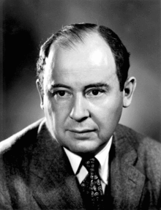
John Von Neumann
https://en.wikipedia.org/wiki/John_von_Neumann

Slide 3
Architecture / Instruction Set Architecture
Programmer Visible State ( Memory & Register )
Operations ( Instructions and how they work )
Execution Semantics ( Interrupts)
Input / Output , Data Types / Sizes
Micro-architecture / Organization
Tradeoffs on how to implement ISA for some metric (Speed , Energy, Cost)
Examples: Pipeline depth, number of pipelines, Cache size, silicon area, peak power, execution ordering, bus widths, ALU widths

Slide 4
A micro-architecture is the digital logic that allows an instruction set to be executed. It is the combined implementation of registers, memory, arithmetic logic units, multiplexers, and any other digital logic blocks. All of this, together forms the processor.
A micro-architecture combined with an instruction set architecture (ISA) makes up the system's computer architecture as a whole. Different micro-architectures can implement the same ISA, but with trade-offs in things like power efficiency or execution speed. The most basic processor will include a register file, an ALU, system memory, and a control unit that allows the processor to make decisions based on the instruction it's executing.

Slide 5
The micro-architecture is how the ISA is implemented on a given core, like pipeline stages, number of function units, datapaths, caches, etc.
For example both ARM926EJ-S and XScale implement the same architecture (ISA), but they have different micro-architectures.
https://en.wikipedia.org/wiki/List_of_ARM_microarchitectures

Slide 6
The term architecture is used here to describe the attributes of a system as seen by the programmer, i.e., the conceptual structure and functional behavior, as distinct from the organization of the data flow and controls, the logical design, and the physical implementation.
The term computer architecture or just architecture typically encompasses both instruction set architecture and micro-architecture, as well as broader system-level issues like network connectivity on multiprocessors.

Slide 7
Instruction Set Architecture to describe the syntax and semantics of the interface of a computer, including the type and size of the operands, programmer visible register state, the memory model, how interrupts and exceptions are handled, the available instructions and the meaning of each instruction. The instruction set architecture is the boundary between software and hardware, and is the contract between the programmer and the hardware designer.

Slide 8
The term microarchitecture is used to refer to the organization, or highest level of implementation, of a particular processor. The study of microarchitecture would include topics like pipelining, instruction-level parallelism, out-of-order execution, speculative execution, branch prediction and caching.
Microarchitecture, also called computer organization and sometimes abbreviated as µarch or uarch, is the way a given instruction set architecture (ISA), is implemented in a particular processor. A given ISA may be implemented with different micro-architectures; implementations may vary due to different goals of a given design or due to shifts in technology.

Slide 9
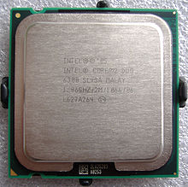
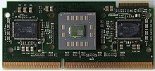
AMD Athlon and Core 2 Duo processors are based on the same ISA but have different microarchitectures with different performance and efficiencies.
This Flexibility is the reason. We first define an ISA and then design different micro-architectures complying to this ISA for implementing the machine.
Intel Core 2 Duo, an example of an x86-compatible, 64-bit multicore processor
AMD Athlon (early version), a technically different but fully compatible x86 implementation

Slide 10
The x86 was developed by Intel, but we see that almost every year Intel comes up with a new generation of i-series processors. The x86 architecture on which most of the Intel Processors are based essentially remains the same across all these generations but, where they differ is in the underlying Microarchitecture. They differ in their implementation, and hence are claimed to have improved Performance. These various Microarchitectures developed by Intel are codenamed as ‘Nehalem’, ‘Sandybridge’, ‘Ivybridge’ and so on.
Conclusion: we can say that different machines may be based on the same ISA, but have different Microarchitectures.

Slide 11
The ARM7TDMI processor is an implementation of the ARMv4T architecture
The LPC2141/42/44/46/48 microcontrollers are based on a 16-bit/32-bit ARM7TDMI-S CPU with real-time emulation and embedded trace support,
TMS470R1x 16/32-Bit RISC Core • 255 Programmable Baud Rates (ARM7TDMI)
https://www.mouser.in/c/semiconductors/embedded-processors-controllers/microcontrollers-mcu/arm-microcontrollers-mcu/?core=ARM7TDMI

Slide 12
Arm is Powering Innovation through Artificial Intelligence
Home Work
An ARM Cortex A8 describes a specific design, whereas ARM v7 describes the CPU instruction set
https://www.arm.com/solutions/artificial-intelligence

Slide 13
How instructions are executed

Slide 14
Translating languages
English: Display the sum of A times B plus C.
C++:
cout << (A * B + C);
Intel Machine Language:
A1 00000000
F7 25 00000004
03 05 00000008
E8 00500000
Assembly Language:
mov eax,A
mul B
add eax,C
call WriteInt

Slide 15
Virtual machines
Abstractions for computers

Slide 16
High-level language
Level 5
Application-oriented languages
Programs compile into assembly language (Level 4)
cout << (A * B + C);

Slide 17
Assembly language
Level 4
Instruction mnemonics that have a one-to-one correspondence to machine language
Calls functions written at the operating system level (Level 3)
Programs are translated into machine language (Level 2)
mov eax, A
mul B
add eax, C
call WriteInt

Slide 18
Operating system
Level 3
Provides services
Programs translated and run at the instruction set architecture level (Level 2)

Slide 19
Instruction set architecture
Level 2
Also known as conventional machine language
Executed by Level 1 program (microarchitecture, Level 1)
A1 00000000
F7 25 00000004
03 05 00000008
E8 00500000

Slide 20
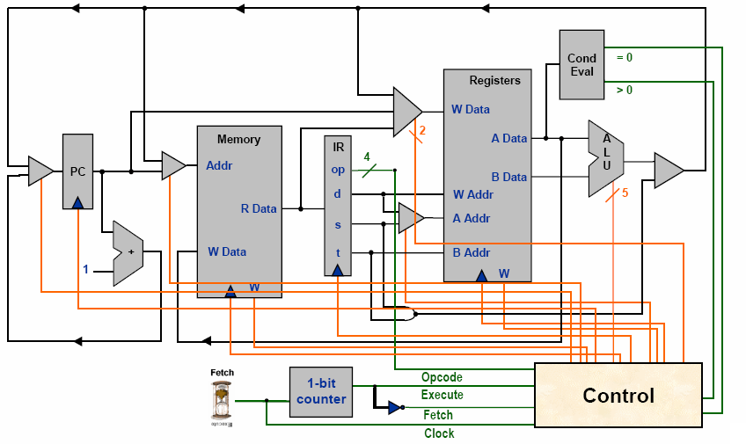
Microarchitecture
Level 1
Interprets conventional machine instructions (Level 2)
Executed by digital hardware (Level 0)

Slide 21
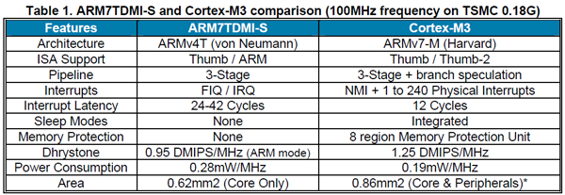

Slide 22

Dipesh Patel CTO ARM
https://www.linkedin.com/in/dipesh-patel-9916bb3

Slide 23
Queries ?
ARM Architecture

